Slide 1
Dashboard Monitoring Piloting SPAN

Slide 2
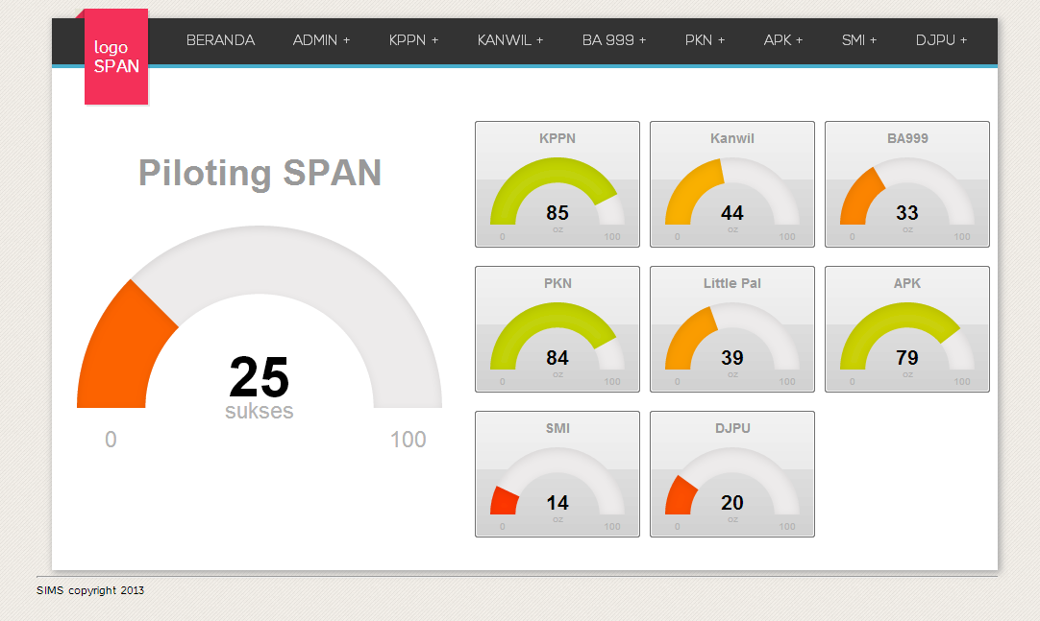
Dashboard Level 1

Slide 3
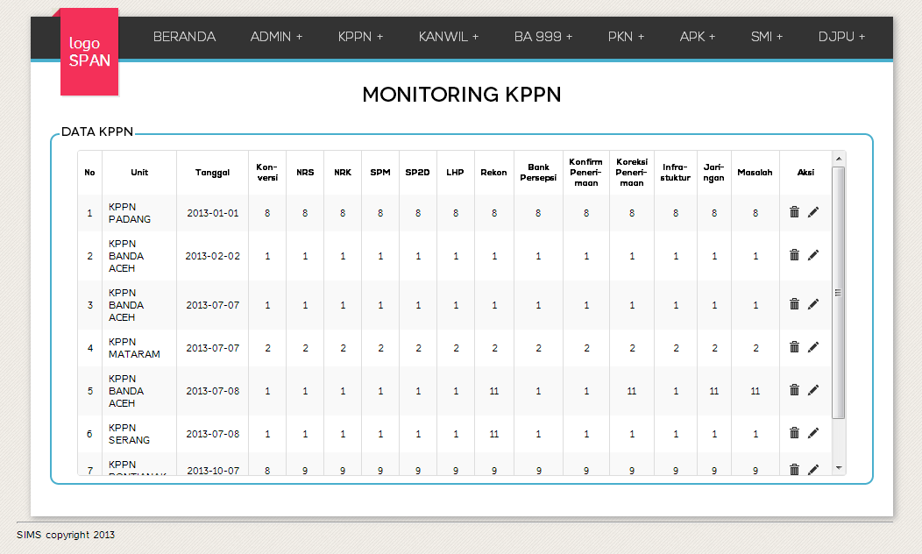
Dashboard Level 2

Slide 4
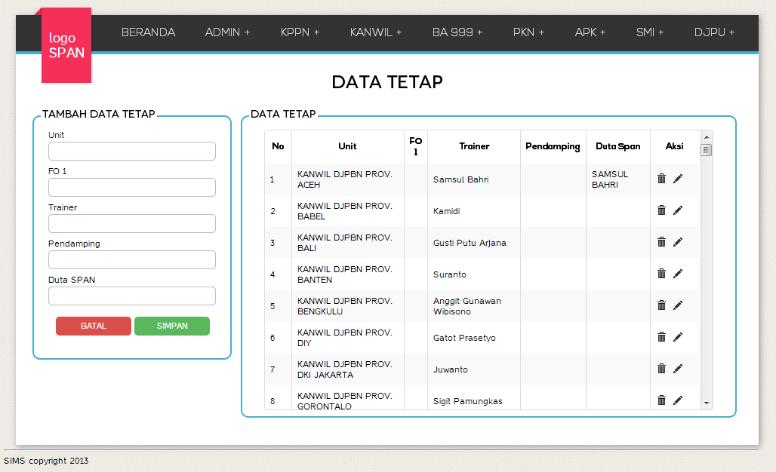
User TP
dipakai saat terjadi perubahan data tetap

Slide 5
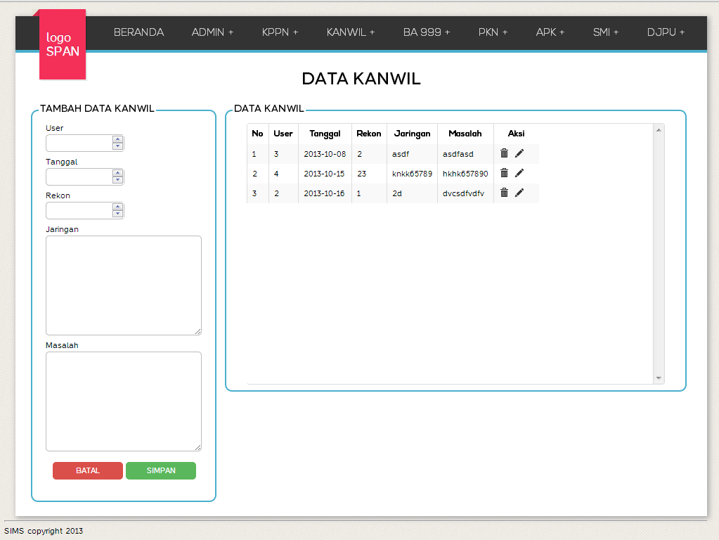
User Unit

